Slide 1

Adaptive Navigation of Multi-Robot Systems in Vector Fields
Christopher Waight
Santa Clara University
Mechanical Engineering Department
May 17, 2024
Notes:
Kyra rini
Kitts Lee
Marks Neumann

Slide 2
Agenda
Introduction
Problem Statement
Literature Review
Methodology
Preliminary Results
Expected Outcomes
Timeline
Implication of Findings
Summary
Question and Answers

Slide 3
Introduction Problem Statement Literature Review Methodology Preliminary Results Expected Outcomes Timeline Implication of Findings Summary Question and Answers

Slide 4
Introduction
Robotics
Autonomous (Adaptive)
Single Robot Systems
Multi-Robot Systems
Homogenous
Adversarial
Collaborative
Heterogeneous
Human Controlled
Human in the Loop
Formation Control
Task Execution
Navigation
Scalar Fields
Vector Fields
Autonomous (Conventional)
Adaptive techniques are robust when the environment or system dynamics are not fully known, unknown, or dynamic. [1]
Multirobot systems are coordinated group of robots that often have capabilities beyond the sum of individual robots [5].
They maintain benefits of individual robots such as precision, repeatability and resilience to harsh environments.
They offer redundancy and expanded coverage.
They can collaborate adding benefit beyond individual robots.
They can be used for search and rescue, path exploration, and environmental monitoring[12].
Notes:
Give a definition for adaptive navigation in robotics.

Slide 5
Adaptive Navigation Techniques
Memory Based Navigation
Has a memory component with knowledge of the environment (or builds it up over time or many iterations).
Can use historical date to estimate current state within environment.
Examples: Artificial Neural Tissues[25], model estimator techniques. [28] [20], multi-agent reinforcement learning
Pros: Can learn optimal solution, provide noise rejection, great for mapping
Cons: Memory intensive, computationally expensive, may struggle in dynamic environment, may require training
Memory Free Navigation
Models are completely reactive and offer a memoryless approach to navigation.
Instantaneous estimation of the environment with no need for historical data.
Navigation to and around extrema, ridges, trenches, saddle points[10], fronts[9], plumes, [27],[15] as well as search patterns[30].
Have been verified in simulation and on physical test beds.
Examples: Simple Reflect Agents, Multirobot Potential Field Methods[7],[8,[10]
Pros: great for a dynamic environment, low computational demands, quick response to real time obstacle, basis for efficient memory-based models.
Cons: potentially inefficient routing, vulnerable to noise, struggle in complex environment.
Notes:
Both methods have shown success with centralized and decentralized architectures.
Adaptive Navigation in Scalar Fields is well studied.
Adaptive Navigation in Vector Fields is in its infancy.

Slide 6
Introduction Problem Statement Literature Review Methodology Preliminary Results Expected Outcomes Timeline Implication of Findings Summary Question and Answers
How effectively can multirobot systems utilize adaptive navigation techniques for maneuvering within complex and dynamic vector fields to and along regions of interest?

Slide 7
How effectively can multirobot systems utilize adaptive navigation techniques for maneuvering within complex and dynamic vector fields to and along regions of interest?
Challenges to AN in Vector Fields:
Computational Challenges – Vectors contain more data, inherently requiring more real-time computation power [23].
Dynamic Environments - Vector Fields can change unpredictably, requiring algorithms to adapt in real-time.
Robustness - Communication between robots may not be perfect, and sensor readings may be imperfect.
Robot-Environment Interaction –a vector field may change the trajectory of a robotic system.
Environmental Modelling – Much more difficult to model compared to scalar fields
Motivation to develop AN in Vector Fields :
Autonomous Navigation - Enables exploration and navigation in harsh and communication denied environments.
Energy Efficiency - Robotic Systems can exploit features of the vector fields such as tailwinds and stable manifolds.
Obstacle Avoidance - Enables obstacle avoidance in avoiding regions of turbulence or extreme conditions.
Cross-Sectoral Applications - navigation through atmospheric systems, rivers, aquatic bodies, off-planet exploration (magnetic and gravitational fields) [25] [26]

Slide 8
Introduction Problem Statement Literature Review Methodology Preliminary Results Expected Outcomes Timeline Implication of Findings Summary Question and Answers
Adaptive Navigation In Vector Fields
Existing Control Primitives
Open Questions

Slide 9
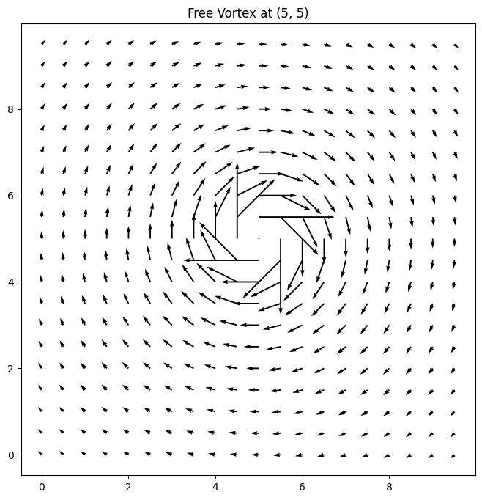
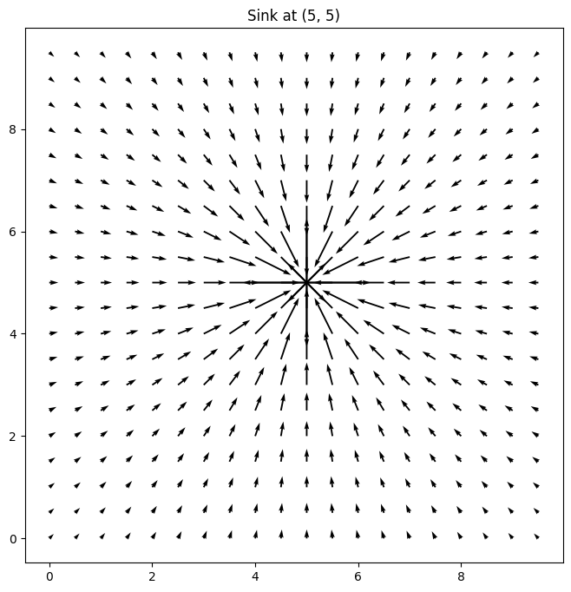
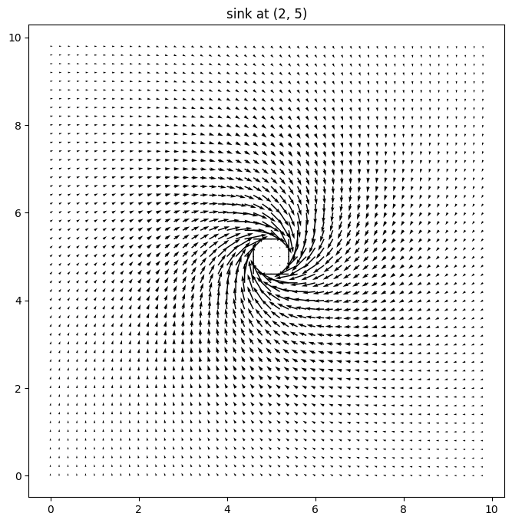
Adaptive Navigation in Vector Fields
Artificial Vector Fields
Robot systems create artificial vector fields and are used to guide individual robot navigation. [17],[18], [19], [21], [29]
Natural Vector Fields
Cooper, Ryan, et al. "Initial Study of Multirobot Adaptive Navigation for Exploring Environmental Vector Fields.” [13]
Environment Modelling - Construction of Vector Fields using Helmholtz Decomposition. [33]
Control Primitives – 2x: ‘Vector to Scalar’ and ‘Direction Follower’ primitives have demonstrated success in extrema seeking.
Test Bed - Rajabhandharaks, Danop, et al. "Indoor Testbed for Vector Field Multirobot Adaptive Navigation: Feasibility Study." [22]

Slide 10
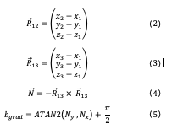
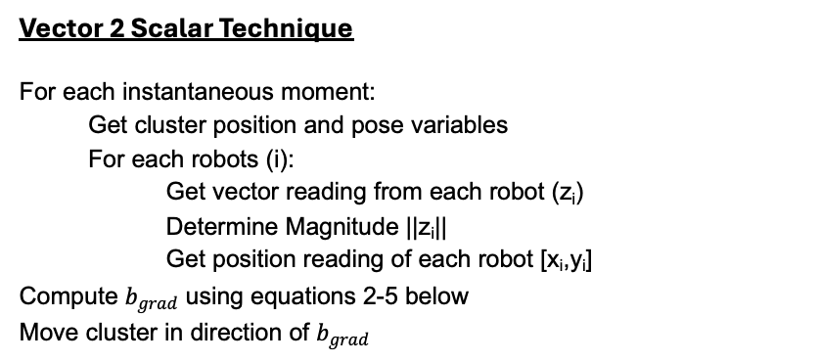
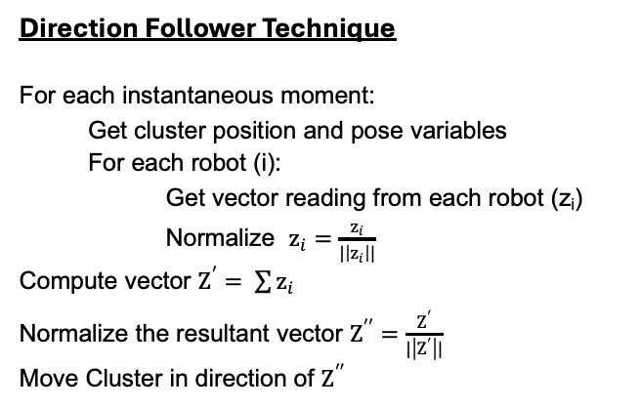
AN Control Primitives
Cooper, Ryan, et al. "Initial Study of Multirobot Adaptive Navigation for Exploring Environmental Vector Fields.” [13]
Both techniques were used for navigation to extrema.
Both techniques convert vector data to scalar data by removing either magnitude data or direction data.
Vector 2 Scalar Technique
For each instantaneous moment: Get cluster position and pose variables For each robots (i): Get vector reading from each robot (z_{i}) Determine Magnitude ||z_{i}|| Get position reading of each robot [x_{i},y_{i}] Compute $b_{grad}$ using equations 2-5 below Move cluster in direction of $b_{grad}$
Direction Follower Technique
For each instantaneous moment: Get cluster position and pose variables For each robot (i): Get vector reading from each robot (z_{i}) Normalize $z_{i}=\frac{z_{i}}{|\left|z_{i}\right||}$ Compute vector $Z^{′}= \sum{z_{i}}$ Normalize the resultant vector $Z^{′′}=\frac{Z^{′}}{|\left|Z^{′}\right||}$ Move Cluster in direction of $Z^{′′}$

Slide 11
Open Questions
What other information can we get from distributed vector readings?
Can we Identify a list of features of interest in vector fields other than extrema?
Can we discover control primitives to navigate to and around these features?
Is there a minimum number of robots required for primitives?
How does the configuration of these robots affect the control primitive’s performance?
Are these methods computationally scalable?
Are these methods stable?
Do these methods work if sampling is not continuous?
How does imperfect communication affect performance between robots?
What if the environment is dynamic?
Will the interaction between Vector Fields and robot affect the ability to navigate?
How effectively can multirobot systems utilize adaptive navigation techniques for maneuvering within complex and dynamic vector fields to and along regions of interest?

Slide 12
Introduction Problem Statement Literature Review Methodology Preliminary Results Expected Outcomes Timeline Implication of Findings Summary Question and Answers
Cluster Space Control Architecture
Control Block Diagram
Simulation Tools
Indoor Test Beds
Potential Outdoor Test Beds

Slide 13
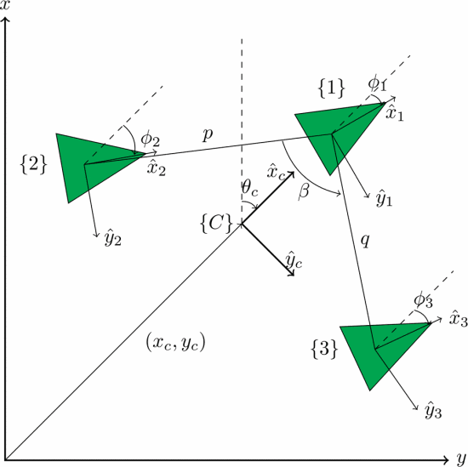
Cluster Space Control Architectures
C. A. Kitts and I. Mas, "Cluster Space Specification and Control of Mobile Multirobot Systems," in IEEE/ASME Transactions on Mechatronics, vol. 14, no. 2, pp. 207-218, April 2009, doi: 10.1109/TMECH.2009.2013943. [2]
Considers the n- robot as a single system or cluster.
A cluster reference frame is defined as a function of 1 or more robots.
Cluster shape is described with cluster space variables are chosen by operator based on preference. (p=q=0.854, and beta = 4pi/35 )
The position and orientation of each robot is then considered relative to the cluster frame using cluster space variables.
Jacobian and Jacobian Inverse - Transforms between robot space variables and cluster space variables are developed geometrically/algorithmically.

Slide 14
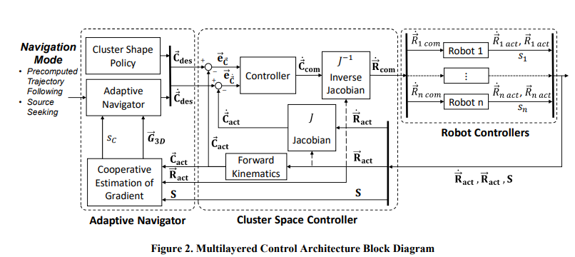

Control Block Diagram
Alternate Control Architectures:
Centralized – cluster control, leader-follower chains, …
Decentralized – Reactive particle swarms[8][7], Consensus Swarms[28], Artificial Neural Tissues, …
Self Organizing – local rule based, emergent behavior technique …

Slide 15
Control Block Diagram
Info
Control Primitive
V
V
V
Alternate Control Architectures:
Centralized – cluster control[2], leader-follower chains …
Decentralized – Reactive particle swarms[8],[7], ], Consensus Swarms[28 ,Artificial Neural Tissues[25], ..
Self Organizing – local rule based, emergent behavior technique

Slide 16
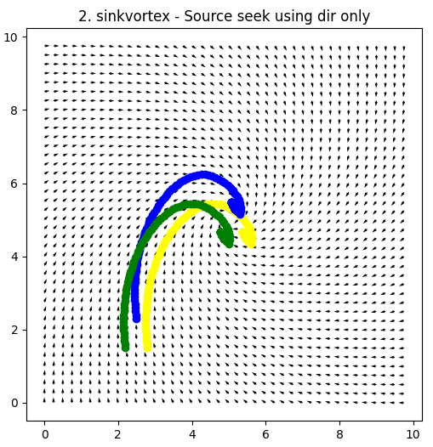
Simulation
Simulation work will be done in Python 3.9 using standard libraries (numpy, matplotlib)
Vector Fields will be modelled using superpositions of curl free and divergence free components.
Robots will be abstracted to point masses with first order dynamics for simulations.
Will consider the robot interactions with environment, and independent from the environment.
Cluster Shapes and starting locations of robots will be randomized for testing.

Slide 17
Indoor Test Bed
Indoor Test Bed developed here at SCU that can be used for testing planar multirobot systems in both scalar and vector fields.
Consists of
Omnibots – which have omniwheels, and and RGB sensor.
Communication over TCP/IP
Centralized computation handled offboard on a computer (Windows, using Matlab/Simulink)
Vector Fields will be represented with RGB colors on the ground.
Position of robots will be tracked using OptiTrack.

Slide 18
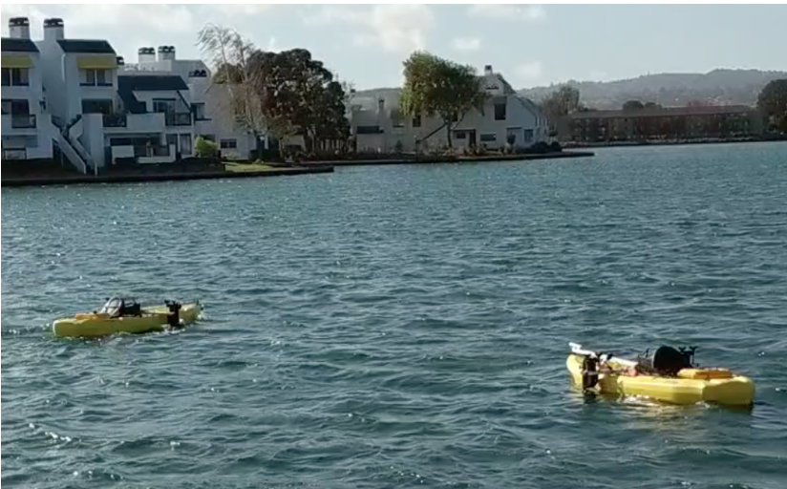
Potential Outdoor Tests
Kayaks at Elkhorn Slough

Slide 19
Introduction Problem Statement Literature Review Methodology Preliminary Results Expected Outcomes Timeline Implication of Findings Summary Question and Answers
Areas of Interest Identified
Using Existing Primitive to find Stagnation Point
New Primitive to traverse Separatrix

Slide 20
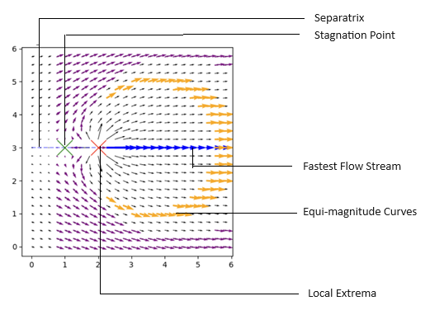
Regions of Interest
Region of Interest | How to Model | Importance
Extrema points | Sinks , Sources , Dipoles Rankine Vortex , Fixed Vortex, Free Vortex Sink + Vortex, Source + Vortex, Spring in Stream Opposing Vortices , Corotating Vortices | Location of a spring in a stream Source of magnetic pole Centre of gravity
Equimagnitude Contours | Sinks, Sources , Dipoles Rankine Vortex , Fixed Vortex Free Vortex, Sink + Vortex, Source + Vortex Spring in Stream, Opposing Vortices, Corotating Vortices | Staying within safe operating conditions
Fastest Flow Stream | Corotating Vortices, Superimposed Linear Streams, Spring in Stream Dipole, Vortex in Stream Opposing Vortices, Rankine Vortex | Locate wall of hurricane Fastest Tailwinds Fastest flow for fish or debris
Separatrix | Dipole , Vortex in stream Opposing Vortices, Opposing Streams, Spring in Stream, Corotating Vortices | Path that delineates bifurcating trajectories
Stagnation Point | Spring in Stream, Opposing Vortices Vortex in Stream, Opposing Streams Superimposed Linear Streams
Boundary Layers | Blasius equations?

Slide 21
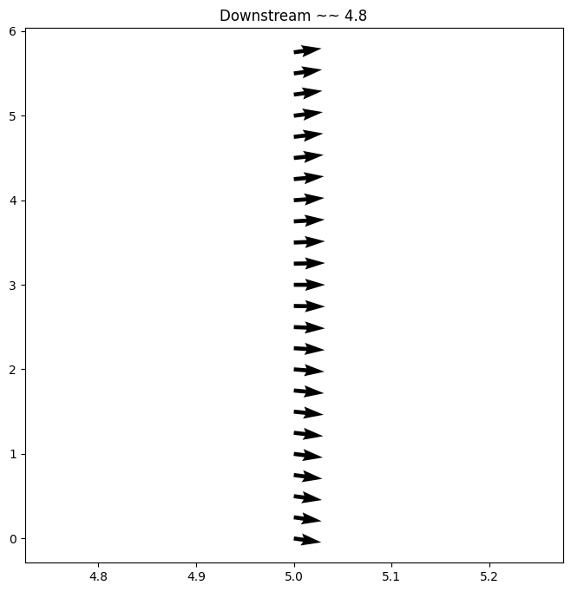
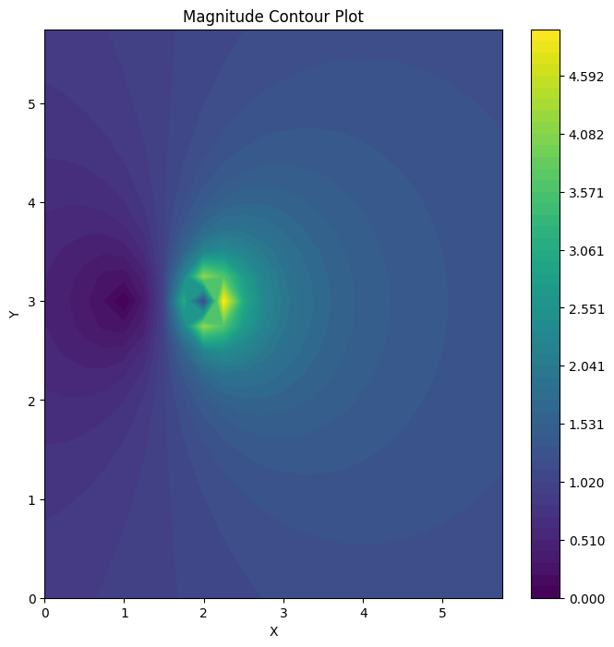
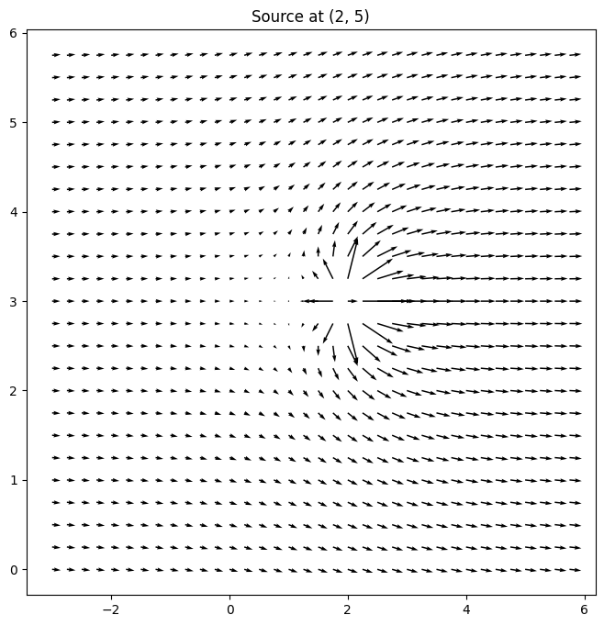
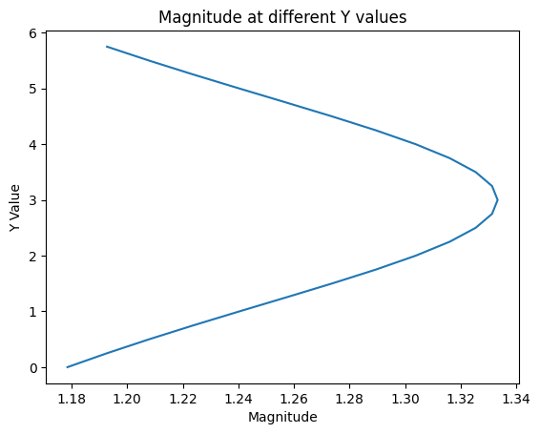
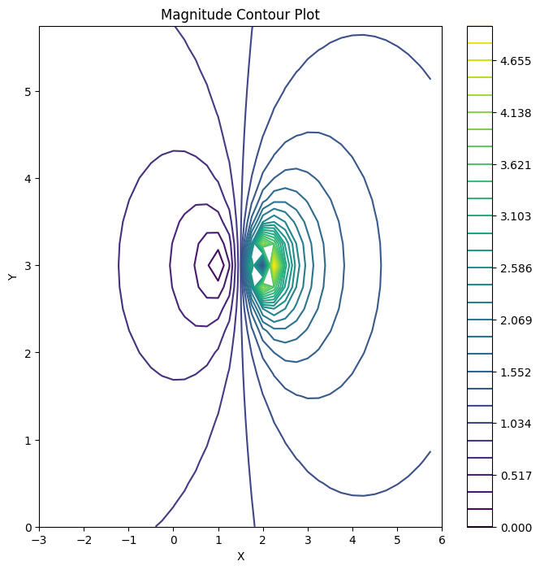
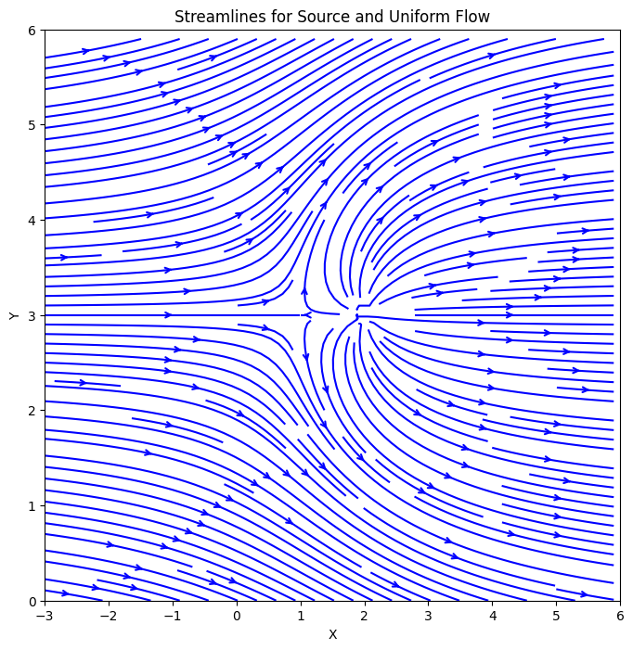
Stagnation point
Notes:
A parabola is the limit curve of a pencil of ellipses with a common vertex and one common focus, as the other focus is moved to infinity to the right, and also the limit curve of a pencil of hyperbolas with a common vertex and one common focus, as the other focus is moved to infinity to the left.

Slide 22
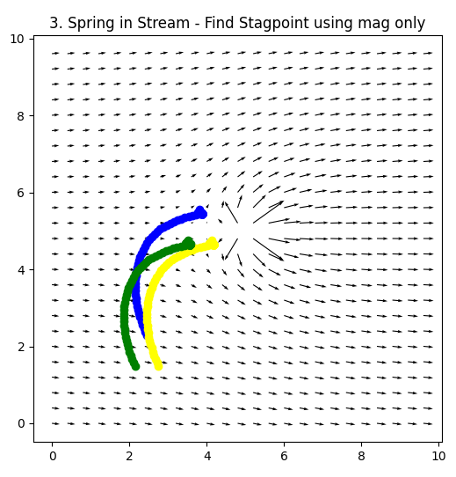
Stagnation point located using modified vec2scalar technique.

Slide 23
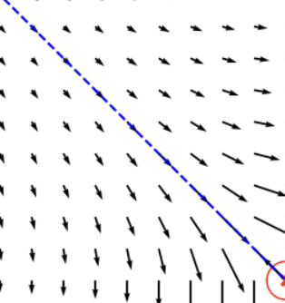
Separatrix Riding Technique
A separatrix bifurcates the dynamics of a vector field.
This is also an unstable manifold.
If an number of points are placed along the separatrix, the number of points on either side would be imbalanced.
Averaging and median techniques would favor divergence from separatrix.

Slide 24
Separatrix Riding Technique
For each instantaneous moment:
Get cluster position and pose.
Get vector reading from each of 3 robot (zi).
Calculate the vector sum of each reading Zhat
Choose the vector that has the highest cosine score with Zhat as Zclose
Determine Cosine similarity of each robot reading to Zclose
Select Robot Reading with the lowest cosine similarity score (zi)
Move cluster in the direction robot reading zi,

Slide 25
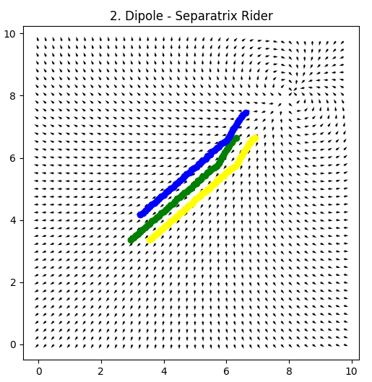
Separatrix Riding Technique
Moving upstream is the same as source seeking.

Slide 26
Introduction Problem Statement Literature Review Methodology Preliminary Results Expected Outcomes Timeline Implication of Findings Summary Question and Answers
Expected Results
Expected Challenges

Slide 27
Expected Results at Completion
Development of a Vector Field modelling tool to include features such as boundary layers.
Catalog of Vector Field Features.
Design and Analysis of Vector Field Primitives
Stability (within certain bounds or in the sense of Lyapunov).
Performance as a function of robots.
Robustness to noise.
Performance as a function of shape.
Computational Scalability Analysis
Best Use Cases
Experimental verification of 2D cases on indoor test bed.

Slide 28
Expected Challenges and Mitigations
Imperfect communication between robots – Control architecture is modular to test decentralized controller.
Computation time – Runtime Optimization analysis will be performed.
Robot Collison– A self collision routine may need to be developed [31].
Degenerate Formations – Formation control may need singularity avoidance techniques [14]
Dynamic Environments – Temporal modelling aspect must be developed.
3D Visualizations – Explore visualization libraries or switch to unreal or to unity environments [6]

Slide 29
Introduction Problem Statement Literature Review Methodology Preliminary Results Expected Outcomes Timeline Implication of Findings Summary Question and Answers

Slide 30
Next Steps
May – Add boundary layers to simulation tool.
June – Analysis of primitives (computational complexity and stability)
July – Perform test on physical test bed.
August – Analyze effect of additional robots in simulation
September – Perform tests on physical test bed
October – Analysis of cluster size and shape in simulation
November - Perform tests on physical test bed
Dec - Investigate decentralized control with vector fields
----------------------------------------------------------------------------------------------------------------
Jan - Perform tests on physical test bed
Feb – Investigate 3D Vector Fields and Design and Analysis of Primitives
March – Plan and Design and Outdoor test for vector fields
April – Perform outdoor Test
May – Thesis Writing and Defending
June – Hand-off

Slide 31
Introduction Problem Statement Literature Review Methodology Preliminary Results Expected Outcomes Timeline Implications Summary Question and Answers

Slide 32
Implications of Findings / Potential Next Steps
Primitive forms can be implemented in real life in a cross sectoral applications such as:
Making aerial drones more efficient
More offshore exploration in our oceans and streams
Unsupervised off-planet exploration.
The modular aspect of this design means that these findings can be easily incorporated into existing controllers.
Provides an ethical way to navigate without retaining sensitive information.
Potential insights into Adaptive Navigation in Scalar Fields.

Slide 33
Introduction Problem Statement Literature Review Methodology Preliminary Results Expected Outcomes Timeline Implications Summary Question and Answers
Problem Statement
Importance
Recap of Current Efforts

Slide 34
Summary
Multirobot Navigation of Vector Fields is in its infancy, with and extrema seeking and crest seeking demonstrated.
How effectively can multirobot systems utilize adaptive navigation techniques for maneuvering within complex and dynamic vector fields to and along regions of interest?
This research will extend the work of multirobot in vector fields by:
Creating a methodological way of modelling vector fields for multirobot research.
Creating a catalogue of regions of interest within vector fields.
Design and Analysis of control primitives for vector fields..
Demonstrate success off these primitives in simulation and on a physical test bed.
Findings can be implemented in existing controller architectures, and is applicable in sea, sky, and space.

Slide 35
Thank you
Question and Answers

Slide 36
Appendix
Vector Sum Technique
Intersecting Vector Technique
Additional Slides

Slide 37
AN Primitive - Vector Sum Technique
Vector Sum Technique:
For each instantaneous moment:
Get cluster position and pose variables
For each of 3 robots:
Get vector reading from each robot (zi)
Compute vector Z = sum( Z)
Move Cluster in direction of Z
Since this technique still only involves moving in the direction of Z, it offers nothing new.
Can the magnitude of the z vector be used to determine step size or as a feedback gain?

Slide 38
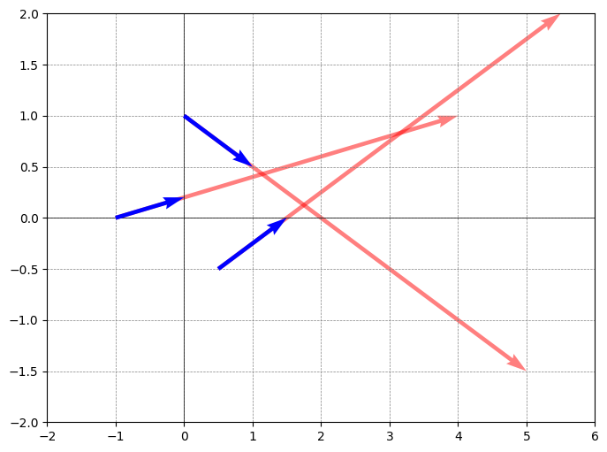
AN Primitive - Intersecting Vectors Technique
For each instantaneous moment:
Get vector reading from each robot
For each pair of vector readings:
Compute point, Pi, of intersection of both vectors.
Append Pi to P
Calculate Phat =average (P)
# Direction of Phat guides direction of cluster direction
Calculate Pvar = variance(P)
Calculate Vector from from Robot Cluster to Phat
Choose hyperparameters W1 and W2
Step_size = W1*||Phat|| + W2/var(P)

Slide 39
References
[1] Adamek, Thomas, Christopher A. Kitts, and Ignacio Mas. "Gradient-based cluster space navigation for autonomous surface vessels." IEEE/ASME Transactions on Mechatronics20.2 (2014): 506-518.
[2] C. A. Kitts and I. Mas, "Cluster Space Specification and Control of Mobile Multirobot Systems," in IEEE/ASME Transactions on Mechatronics, vol. 14, no. 2, pp. 207-218, April 2009, doi: 10.1109/TMECH.2009.2013943.
[3] I. Mas, S. Li, J. Acain, and C. A. Kitts, “Entrapment/escorting and patrolling missions in multi-robot cluster space control,” in Proc. IEEE/RSJ Int. Conf. Intell. Robots Syst., St. Louis, MO, USA, Oct. 2009, pp. 5855– 5861.
[4] M. Woolsey, C. A. Kitts and M. A. Neumann, "Gradient-based Adaptive Navigation of Multiple Diving Autonomous Surface Vehicles," OCEANS 2022, Hampton Roads, Hampton Roads, VA, USA, 2022, pp. 1-8, doi: 10.1109/OCEANS47191.2022.9977006.
[5] C. A. Kitts and M. Egerstedt, “Design, control, and applications of real world multirobot systems [from the Guest Editors],” IEEE Robot. Autom. Mag., vol. 15, no. 1, p. 8, Mar. 2008.
[6] Lee, Robert K., et al. "3-d adaptive navigation: Multirobot formation control for seeking and tracking of a moving source." 2020 IEEE Aerospace Conference. IEEE, 2020.
[7] S. T. Hart and C. A. Kitts, "Unifying Control Architecture for Reactive Particle Swarms," in IEEE/ASME Transactions on Mechatronics, vol. 28, no. 2, pp. 873-883, April 2023, doi: 10.1109/TMECH.2022.3211155.
[8] Hart, Shae T., Jake Kamenetsky, and Christopher A. Kitts. "Dynamic Elliptical Shaping Control for Swarm Robots." IEEE Access 11 (2023): 17454-17470
[9] McDonald, Robert T., et al. "Navigation of scalar fronts with multirobot clusters in simulation and experiment." IEEE Systems Journal 14.3 (2020): 3755-3766.
[10] C. A. Kitts, R. T. McDonald, and M. A. Neumann, “Adaptive navigation control primitives for multirobot clusters: Extrema finding, contour following, ridge/trench following, and saddle point station keeping,” IEEE Access, vol. 6, pp. 17 625–17 642, 2018.
[11] Trakas, Panagiotis S., Andreas Tantoulas, and Charalampos P. Bechlioulis. "Formation Control of Nonlinear Multi-Agent Systems with Nested Input Saturation." Applied Sciences 14.1 (2023): 213.
[12] Matveev, Alexey, et al. "Non-Gradient Based Tracking of Environmental Field Isolines in a Changing Medium by Dubins-Vehicle Type Robots." IEEE Transactions on Automatic Control (2023).
[13] Cooper, Ryan, et al. "Initial Study of Multirobot Adaptive Navigation for Exploring Environmental Vector Fields." 2019 IEEE Aerospace Conference. IEEE, 2019.
[14] Mas, Ignacio, and Christopher Kitts. "Quaternions and dual quaternions: Singularity-free multirobot formation control." Journal of Intelligent & Robotic Systems 87 (2017): 643-660.
[15] Wang, J., Guo, Y., Fahad, M., and Bingham, B., 2019, “Dynamic Plume Tracking by Cooperative Robots,” IEEE/ASME Transactions on Mechatronics, early access.
[16] Braquet, Martin, and Efstathios Bakolas. "Vector field-based collision avoidance for moving obstacles with time-varying elliptical shape." IFAC-PapersOnLine 55.37 (2022): 587-592.

Slide 40
References
[17] Liddy, Tommie, et al. "Obstacle avoidance using complex vector fields." Proc. of the 2008 Australasian Conference on Robotics and Automation, Canberra, Australia. 2008.
[18] Nelson, Derek R., et al. "Vector field path following for miniature air vehicles." IEEE Transactions on Robotics 23.3 (2007): 519-529.
[19] Hu, Bin-Bin, et al. "Spontaneous-Ordering Platoon Control for Multirobot Path Navigation Using Guiding Vector Fields." IEEE Transactions on Robotics (2023).
[20] Garg, Kunal, and Dimitra Panagou. "Finite-time estimation and control for multi-aircraft systems under wind and dynamic obstacles." Journal of Guidance, Control, and Dynamics 42.7 (2019): 1489-1505.
[21] Yao, Weijia, et al. "Singularity-free guiding vector field for robot navigation." IEEE Transactions on Robotics 37.4 (2021): 1206-1221.
[22] Rajabhandharaks, Danop, et al. "Indoor Testbed for Vector Field Multirobot Adaptive Navigation: Feasibility Study." International Design Engineering Technical Conferences and Computers and Information in Engineering Conference. Vol. 59292. American Society of Mecha nical Engineers, 2019.
[23] Matveev, Alexey, et al. "Gradient-free tracking of unsteady environmental level sets in dynamic environments by a nonholonomic robot." IFAC-PapersOnLine 53.2 (2020): 9256-9261.
[24] R. K. Lee, C. A. Kitts, M. A. Neumann and R. T. Mcdonald, "Multiple UAV Adaptive Navigation for Three-Dimensional Scalar Fields," in IEEE Access, vol. 9, pp. 122626-122654, 2021, doi: 10.1109/ACCESS.2021.3107854.
[25] Thangavelautham, Jekan, and Yinan Xu. "Co-Evolution of Multi-Robot Controllers and Task Cues for Off-World Open Pit Mining." arXiv preprint arXiv:2009.09149 (2020).
[26] Kalita, Himangshu, et al. "Guidance, navigation and control of multirobot systems in cooperative cliff climbing." arXiv preprint arXiv:1701.07553 (2017).
[27] Bychkov, I. V., A. A. Tolstikhin, and S. A. Ulyanov. "A lobster-inspired multi-robot control strategy for monitoring non-stationary concentration fields." Journal of Physics: Conference Series. Vol. 2099. No. 1. IOP Publishing, 2021.
[28] Li, Shuai, Ruofan Kong, and Yi Guo. "Cooperative distributed source seeking by multiple robots: Algorithms and experiments." IEEE/ASME Transactions on mechatronics 19.6 (2014): 1810-1820..
[29] Gonçalves, Vinicius Mariano, Ryan McLaughlin, and Guilherme AS Pereira. "Precise landing of autonomous aerial vehicles using vector fields." IEEE Robotics and Automation Letters 5.3 (2020): 4337-4344.
[30] Woolsey, Max, Michael A. Neumann, and Christopher A. Kitts. "Spiral Search Pattern for Scalable Assemblages of Uncrewed Surface Vehicles." OCEANS 2023-MTS/IEEE US Gulf Coast. IEEE, 2023.
[31] Hoy, Michael, Alexey S. Matveev, and Andrey V. Savkin. "Algorithms for collision-free navigation of mobile robots in complex cluttered environments: a survey." Robotica 33.3 (2015): 463-497.
[32] Ogren, Petter, Edward Fiorelli, and Naomi Ehrich Leonard. "Cooperative control of mobile sensor networks: Adaptive gradient climbing in a distributed environment." IEEE Transactions on Automatic control 49.8 (2004): 1292-1302
[33] Bhatia, Harsh, et al. "The Helmholtz-Hodge decomposition—a survey." IEEE Transactions on visualization and computer graphics 19.8 (2012): 1386-1404.

